Slide 1
Road Accident Dashboard Analysis
Client KPI Insights Presentation
Akash Kumar – Data Analysis Project

Slide 2
Project Goal
The client wanted insights from road accident data for the years 2021 and 2022.
The objective is to understand accident patterns and casualty trends.
The dashboard helps analyse accidents by vehicle type, road condition, location, and time.

Slide 3
Dataset Overview
Total casualties analysed: 417,883
Data includes accident severity, vehicle type, road conditions, and location.
The analysis compares trends between 2021 and 2022.

Slide 4
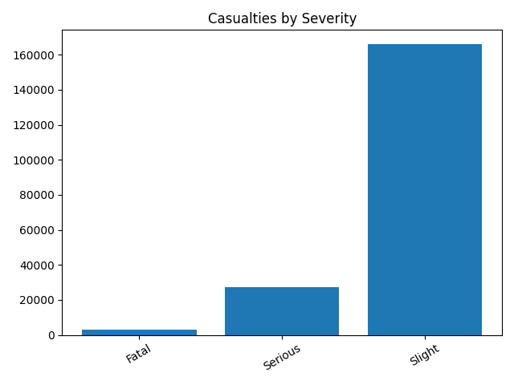
Primary KPI – Casualties by Severity
The total casualties recorded are 417,883.
Most injuries are slight injuries compared to fatal and serious injuries.

Slide 5
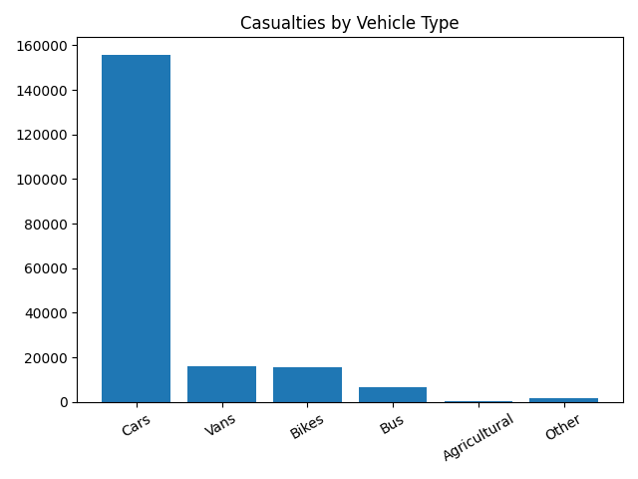
Secondary KPI – Casualties by Vehicle Type
Cars contribute to the highest number of casualties.
This indicates passenger vehicles are most involved in accidents.

Slide 6
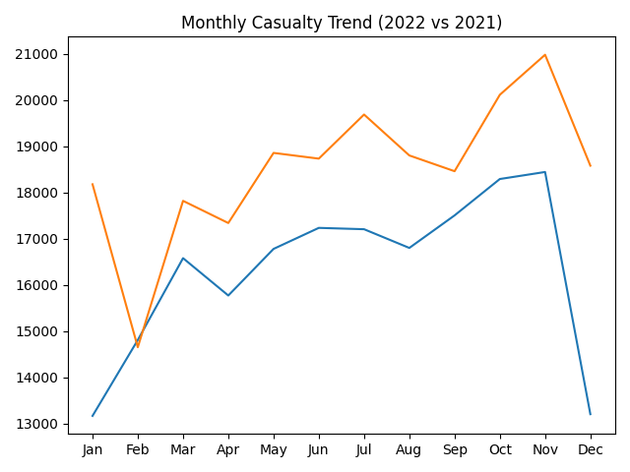
Monthly Casualty Trend
This comparison shows how accident casualties changed month by month between 2021 and 2022.

Slide 7
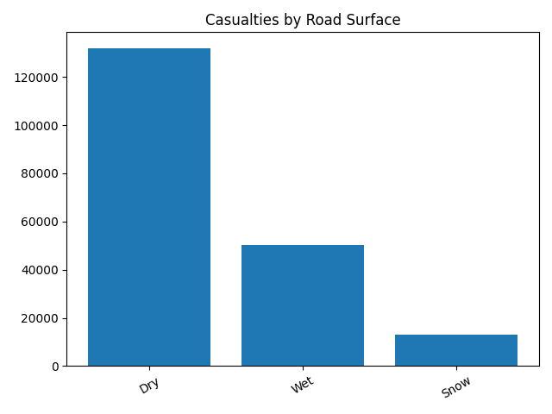
Road Surface Impact on Accidents
Most accidents happen on dry roads, followed by wet and snowy surfaces.

Slide 8
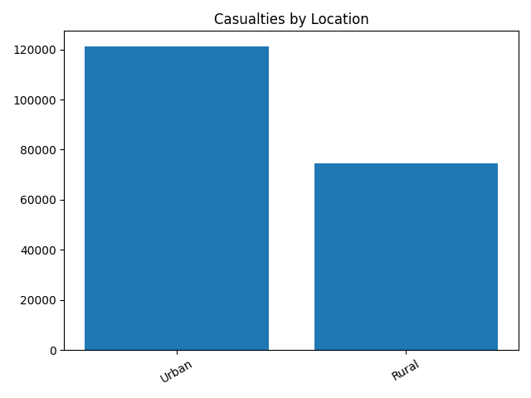
Urban vs Rural Accidents
Urban areas show a higher number of casualties compared to rural areas.

Slide 9
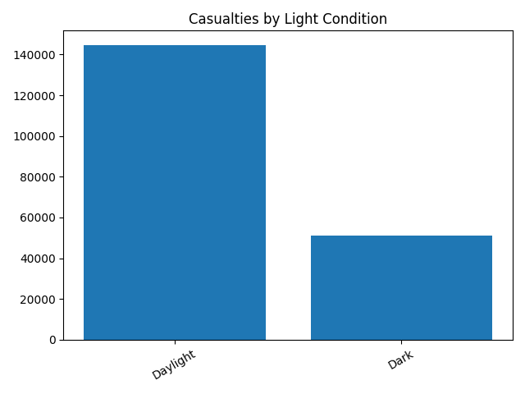
Day vs Night Accident Analysis
Most accidents happen during daylight when traffic is higher.

Slide 10
Key Insights from the Analysis
Cars are responsible for the highest number of casualties.
Urban areas have more accidents than rural areas.
Most accidents occur during daylight hours.
Dry road surfaces show the highest accident counts.

Slide 11
Conclusion
The dashboard helps identify major accident patterns.
Vehicle type, road conditions, and location strongly influence accident rates.
These insights can help improve road safety planning and awareness.

